Slide 1
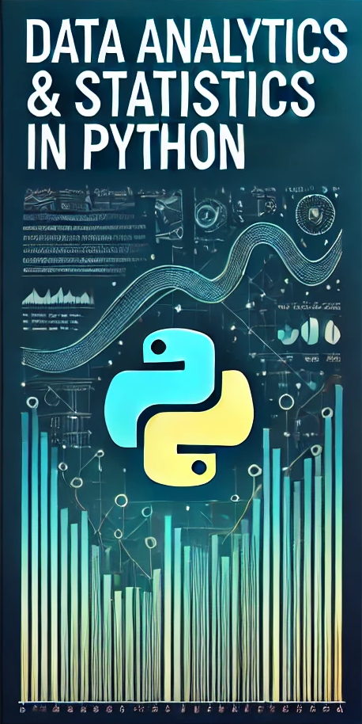

Data Analytics & Statistics in Python Session 2: Data Frames
Learning data-driven decision-making with Python
Instructor: Hamed Ahmadinia, Ph.D.
Email: hamed.ahmadinia@metropolia.fi

Slide 2
Concepts of Today
Data Frames & Matrix:
Arrays and Matrices: Organized data in rows and columns for easy calculations.
NumPy Basics and Advanced Operations: Faster tools for working with large numbers and reshaping data.
Pandas Series and DataFrames: Tables with labels to organize and work with data easily.
Data Editing and Filtering: Clean and filter data to focus on what’s important.
Grouping, Merging, and Concatenating Data: Combine or group data for summaries and comparisons.
Time-Series Data: Data linked to dates and times for tracking changes over time.

Slide 3


Arrays and NumPy Overview
What are Arrays?
Arrays store collections of numerical elements of the same type.
Data is stored contiguously in memory for fast access.
Efficient for numerical operations like addition and multiplication.
What is NumPy?
NumPy: A Python library for working with arrays and matrices.
Why use NumPy?
Faster than Python lists (optimized with C-based operations).
Supports multi-dimensional arrays (like matrices).
Built-in math operations: Addition, multiplication, etc.

Slide 4


Creating Arrays in NumPy
Table 1 : Creating Arrays: Common Methods
Method | Description | Example Output
np.array ([1, 2, 3]) | Converts a list to an array | [1, 2, 3]
np.arrange (0, 10, 2) | Creates evenly spaced values (start, stop, step) | [0, 2, 4, 6, 8]
np.linspace (0, 1, 5) | 5 evenly spaced values between 0 and 1 | [0. , 0.25, 0.5, 0.75, 1. ]
np.zeros ((3, 3)) | 3x3 matrix of zeros | [[0. 0. 0.], [0. 0. 0.], [0. 0. 0.]]
np.ones ((2, 4)) | 2x4 matrix of ones | [[1. 1. 1. 1.], [1. 1. 1. 1.]]
np.eye (3) | 3x3 identity matrix | [[1. 0. 0.], [0. 1. 0.], [0. 0. 1.]]
List to Array
Even Spaced Values

Slide 5
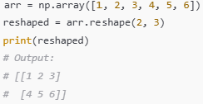

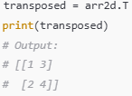
Reshaping Arrays in NumPy
Table 2: Reshaping Arrays: Key Functions
Function | Description | Example Output
reshape() | Reshape array (e.g., 1D to 2D) | Reshapes [1, 2, 3, 4, 5, 6] → [[1, 2, 3], [4, 5, 6]]
ravel () | Flatten multi-dimensional array to 1D | Flattens [[1, 2], [3, 4]] → [1, 2, 3, 4]
T (transpose) | Swap rows and columns | Transposes [[1, 2], [3, 4]] → [[1, 3], [2, 4]]
newaxis | Add new axis for reshaping | Adds dimension to [1, 2, 3] → [[1, 2, 3]]
Reshape 1D to 2D
Flatten Array
Transpose Array

Slide 6

NumPy Overview and Special Values
Why Use NumPy?
Handles large datasets efficiently.
Performs fast numerical calculations (e.g., addition, multiplication).
Widely used for scientific and machine learning tasks.
Special Values in NumPy
NaN (Not a Number) → Represents missing or invalid data
Inf and -Inf (Infinity) → Very large or small values.
Use np.isinf (arr) to check for infinity

Slide 7


Combining and Sorting Arrays
Concatenating Arrays (Joining Arrays)
np.concatenate ((a, b), axis=0) → Joins arrays along rows or columns.
np.vstack ((a, b)) → Stacks vertically (one below the other)
np.hstack ((a, b)) → Stacks horizontally (side by side).
Sorting Arrays (Rearranging Data)
np.sort(arr) → Sorts values in the array.
np.argsort(arr) → Returns positions of sorted values (indices).

Slide 8

Array Masking (Filtering Data)
What is Array Masking?
A way to select elements of an array based on conditions.
Uses boolean arrays (True/False) to filter data.
Logical Operators for Combining Conditions:
& (AND): Both conditions must be True.
| (OR): At least one condition must be True.
~ (NOT): Inverts True to False and vice versa.

Slide 9


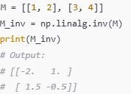
Linear Algebra with NumPy
Key Linear Algebra Operations
np.dot(a, b) → Dot Product (Vector Multiplication): Multiplies and sums corresponding elements
np.linalg.inv(M) → Returns the inverse of a matrix
A @ B → Matrix Multiplication
Multiplies two matrices
Vector Multiplication
Inverse of a Matrix

Slide 10
Pandas – Series and DataFrames
Why Pandas?
Makes working with large datasets easier.
Supports filtering, grouping, and statistical operations.
Integrates well with visualization libraries (e.g., Matplotlib).
Series (1D Labeled Arrays)
A Series is like a one-dimensional array, but with labels (index) for each value.
Useful for representing single columns of data with meaningful labels.
DataFrame (2D Table)
A DataFrame is like a table, with rows and columns.
Each column is a Series and can have different data types.

Slide 11
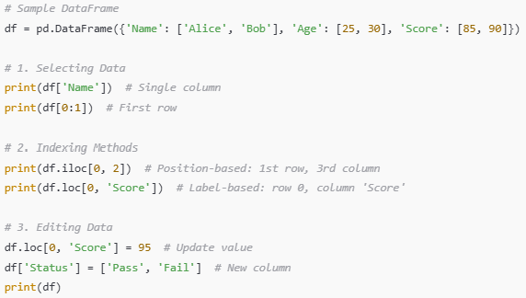
Selecting and Editing Data
Selecting Data
Selecting columns: Choose one or more columns by their names
Selecting rows: Slice rows using their position or labels.
Indexing Methods
iloc[] is great when you need specific rows/columns by position
loc[] is useful when working with labeled data, such as dates or names.
Editing Data
You can modify specific values or entire sections of the DataFrame.
New columns can be added easily by assigning values directly.

Slide 12
Data Handling Methods in Pandas
Table 3: Data Handling and Transformation
Method | Purpose | Example
dropna() | Remove rows/columns with missing values | df.dropna(axis=0, how='any')
fillna (value) | Fill missing values with a specific value | df.fillna(0)
isna() | Identify missing values | df.isna()
apply(function) | Apply a function to columns/rows | df['Square'] = df['Age'].apply(lambda x: x ** 2)
map(mapping) | Map specific values in a column | df['Group'] = df['Age'].map({25: 'Young', 30: 'Adult'})
rename() | Rename columns | df.rename(columns={'Name': 'FullName'})
astype(dtype) | Change data type of a column | df['Age'] = df['Age'].astype(float)

Slide 13
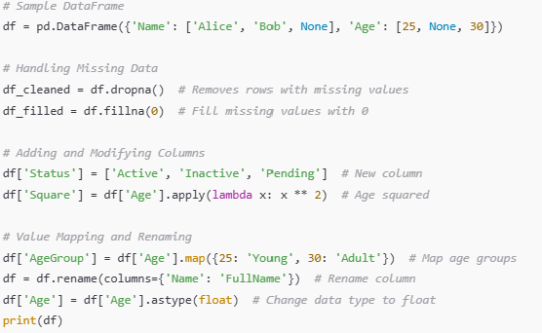
Example of Data Handling and Transformation

Slide 14
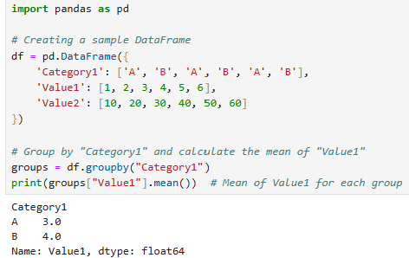
Grouping Data in Pandas
Grouping Data
Purpose: Group rows based on one or more columns and apply aggregation functions (e.g., mean(), sum()).
Method: groupby()

Slide 15
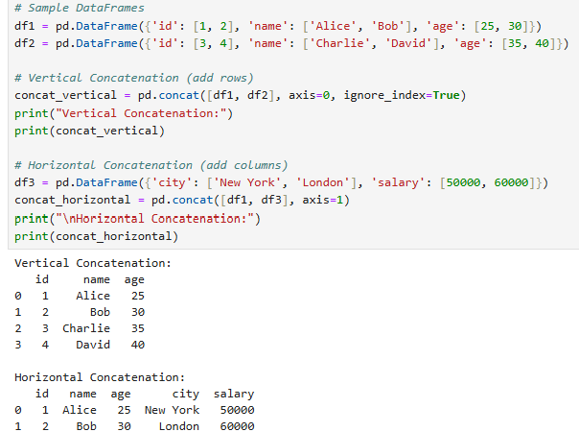
Time-Series Data
Concatenating DataFrames
Purpose: Combine DataFrames vertically (rows) or horizontally (columns).
Method: pd.concat()
Parameter | Description
objs | List of DataFrames to combine
axis | 0 for rows (default), 1 for columns
join | outer (union), inner (intersection)
ignore_index | Reassign row index if True

Slide 16
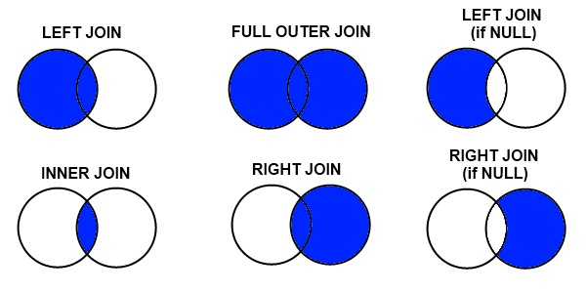
Merging DataFrames in Pandas
Merging Data
Purpose: Combine DataFrames based on common columns or indices.
Method: merge()
Parameter | Description
on | Column name to merge on
how | Type of merge (left, right, inner, outer)
left_on/right_on | Specify columns if names differ

Slide 17
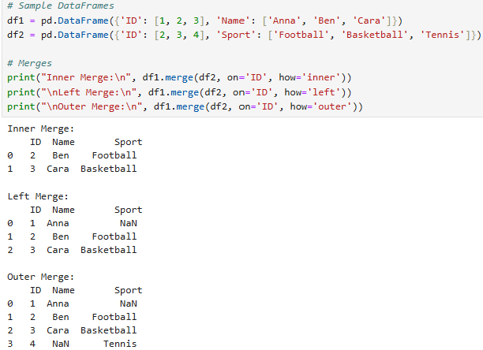
Example for Types of Merges

Slide 18
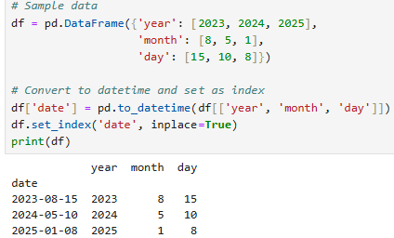
Time-Series Data in Pandas
Key Concepts:
Datetime Objects: Represent dates and times with properties like year, month, day, hour, etc.
Time-Series Data: Data indexed by timestamps, commonly used in financial and weather datasets.
Creating Time Series:
Converting to Datetime: pd.to_datetime() converts date strings or columns into datetime format.

Slide 19
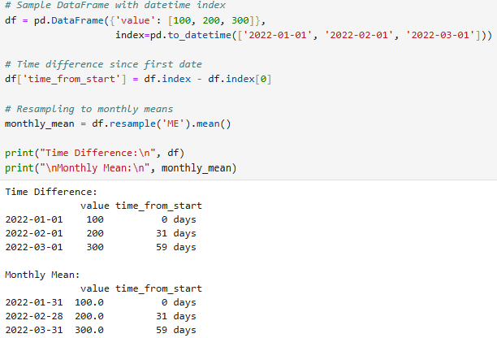
Time-Series Operations in Pandas
Key Operations:
Indexing and Slicing: Select data for specific date ranges using df.loc['start_date':'end_date’].
Date Arithmetic: Subtract dates to calculate time differences (e.g., days between events).
Resampling: Adjust time-series frequency:
Upsampling (Daily): df.resample('D').mean()
Downsampling (Monthly): df.resample(‘ME').sum()

Slide 20
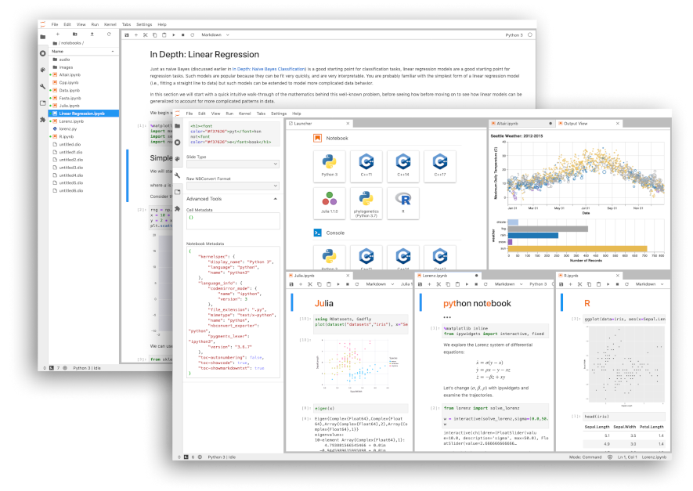
Notebook Review
Walk through how to apply key Python concepts in a Jupyter Notebook:
Arrays and Matrices
NumPy Basics and Advanced Operations
Pandas Series and DataFrames
Data Editing and Filtering
Grouping, Merging, and Concatenating Data
Time-Series Data

Slide 21


Kahoot Quiz Time!
Let’s Test Our Knowledge!

Slide 22

Hands-on Exercise
Form groups (2–3 members).
Download Hands-on Exercise #2 from the course page.
Complete the coding tasks and discuss your solutions.
Don’t forget to add the names of your group members to the file.
Submit your completed Hands-on Exercise to the course Moodle page or send it to the teacher's email address.

Slide 23
Reference
Vohra, M., & Patil, B. (2021). A Walk Through the World of Data Analytics. , 19-27. https://doi.org/10.4018/978-1-7998-3053-5.ch002.
VanderPlas, J. (2016). Python data science handbook: Essential tools for working with data. O'Reilly Media. Available at https://jakevdp.github.io/PythonDataScienceHandbook/
Severance, C. (2016). Python for everybody: Exploring data using Python 3. Charles Severance. Available at https://www.py4e.com/html3/
McKinney, W. (2017). Python for data analysis: Data wrangling with pandas, NumPy, and Jupyter. O'Reilly Media.

